Slide 1

Python Course Chapter 10
Useful Modules

Slide 2
OS Module
When working with files, we would want to work with File systems as well; then, we will be able to rename, move or create new files. The OS module in Python gives us the ability to write Python codes compatible with any operating system.
Different OS has different syntax in naming the file paths:
In Linux/UNIX and macOS, they use / to separate directory.
In Windows, they use \.
Also, in Linux/UNIX, there’s only one root directory. However, in Windows, we can have A:\, B:\ OR C:\. (The C drive is usually where OS is located in.)

Slide 3
OS Module
Also, different OS has different file systems:
Windows uses NTFS (New Technology Filesystem)
macOS uses APFS (Apple Filesystem)
Linux uses ext4 (Fourth extended filesystem)
In order to fix the difference between the operating system, the Python OS module provides some functions to specify file paths. Therefore, we can make sure our Python code can run in any file system by using the built-in functions.

Slide 4
Comman Functions in OS Module
os.getcwd() - returns a string representing the current working directory.
os.listdir(path=‘.’) - returns a list containing the names of the entries in the directory given by path. Notice that the default argument of os.listdir() is a dot. In both Windows and Linux/UNIX, a dot represents the current directory.
os.curdir – is a constant representing the current directory. For example, it is "." on Linux, Windows, and OS X. It is, however, ":" on old Mac OS 9 systems.
os.pardir – is a constant representing the parent directory.

Slide 5
os.path
os.path.join(path1, path2) – Join one or more path components intelligently.
Some reasons why we use os.path.join() instead of simple concatenation:
Portable - this code can work with any OS.
Smart - We no longer need to worry if that directory path had a trailing slash or not. os.path.join will add it if it needs to.
Clear - It’s simple to read it. Using os.path.join() makes it obvious to other people reading your code that you are working with filepaths. People can quickly scan through the code and discover it's a filepath intrinsically.

Slide 6
os.path
os.path.split(path) - splits the basename and the directory name into a tuple.
os.path.basename(path) – returns the basename of the given path.
os.path.dirname(path) – returns the basename of the given path.
os.path.splitext(path) – returns a tuple that splits the file type from path.
os.path.abspath(path) – returns the absolute path of the given path.

Slide 7
OS Constants
os.name is a constant for us to check the current OS.
In Linux/UNIX or macOS, it represents posix. (Portable Operating System Interface)
In most of Windows’ version, it represents nt. (New Technology)
Some people use sys.platform to get more specific OS information. In Windows, it might show win32 (even if you are in 64-bit version of Windows).
In macOS, we might see darwin (Darwin forms the core set of components upon which Mac OS X and iOS are based.) In Linux, we might see linux2.

Slide 8
Other os.path methods
os.path.isfile(path) – returns a boolean value indicating if the path is a file.
os.path.isdir(path) – returns a boolean value indicating if the path is a directory.
os.path.exists(path) – returns a boolean value indicating if the path (file or directory) exists.

Slide 9
Other os module Function
os.rename(oldpath, newpath) – change the old file name to new file name.
os.remove(filepath) – remove the file of the given path. (This is not invertible! The file is not moved to trash can. Instead, it’s deleted permenantly.)
os.rmdir(directorypath) – if the path of the given directory is empty, then permenantly delete the directory.
os.mkdir(name) – create a new directory.

Slide 10

Safe Delete and Remove Nonempty Directory
What if we want to move something to the trash can, instead of deleting it permanently? We can use the send2trash module from PyPI.
What if we want to remove a non-empty directory? (and supposed you know this is a dangerous move) Well, we can use the shutil module from Python.

Slide 11
os.walk()
os.walk(path) method generates the file names in a directory tree by walking the tree either top-down or bottom-up. For each directory in the tree rooted at directory top (including top itself), it yields a 3-tuple (dirpath, dirnames, filenames).
The os.walk(path) method uses depth-first tree traversal algorithm to decide the order of listing out the folder, subfolder, and files information in a directory.

Slide 12
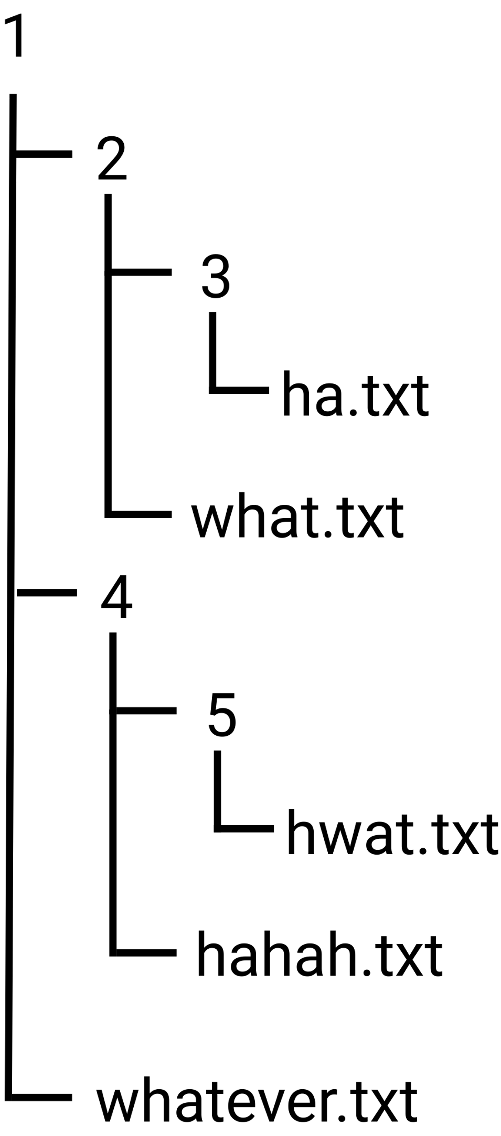
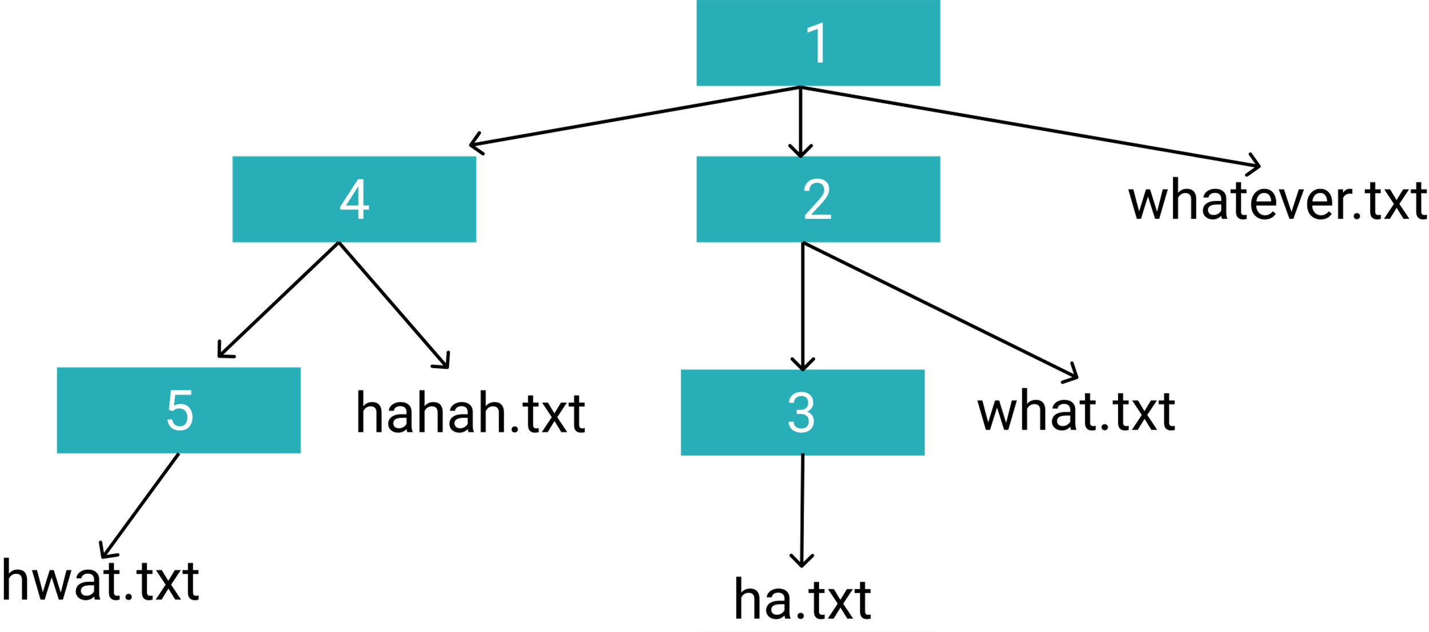
os.walk()

Slide 13

os.walk()
os.walk() is useful when renaming all files or removing some specific files in a directory. It will be a lot faster to use os.walk() to travel through all subdirectories and files. If we were doing this manually, then it would be very annoying.

Slide 14
Collections Module
Python Collections module implements specialized container datatypes providing alternatives to Python’s general purpose built-in containers, dict, list, set, and tuple.
In this chapter, we will learn 3 of the datatypes in this collection module, which is:
Counter
defaultdict
namedtuple()
*. There are other interesting data types, such as deque. However, it requires knowledge of algorithms and data structure, which we won’t talk about here.

Slide 15
Counter
A Counter is a dict subclass for counting hashable objects. (This is why the first letter C is capitalized.) It is a collection where elements are stored as dictionary keys, and their counts are stored as dictionary values.
*. We can definitely implement this datatype from scratch. Actually, this is part of algorithm and data structure course content. You can try to implement Counter if you want to. This will help you be able to answer some coding interview questions.

Slide 16
defaultdict
Just like functions in Python has default parameter, we can make dictionaries in Python have default values as well.
defaultdict is a sub-class of the dictionary class that returns a dictionary-like object. The functionality of both dictionaries and defualtdict are almost same except for the fact that defualtdict never raises a KeyError. It provides a default value for the key that does not exists.
Why is defaultdict lowercase? This is just not following the guidelines of Python. Will they fix it? We don’t know, but people already submitted requests to change the name to be Defaultdict. Hopefully, they will change it sooner or later.

Slide 17
defaultdict
The syntax is:
defaultdict(default_factory)
Where default_factory is a function returning the default value for the dictionary defined. If this argument is absent, then the dictionary raises a KeyError.

Slide 18
Named Tuple
Named tuples are basically easy-to-create, lightweight object types. Named tuple instances can be referenced using object-like variable dereferencing or the standard tuple syntax. (basically, it means that we are giving tuples keys so things in a tuple can be accessed through either key or index. This is like a hybrid of dict and tuple.)
You should use named tuples instead of tuples anywhere we think object notation will make our code more pythonic and more easily readable. Furthermore, we can also replace ordinary immutable classes that have no functions with named tuples.

Slide 19

Datetime Module
The datetime module provides useful methods to work with time in Python. While date and time arithmetic is supported, the focus of the implementation is on efficient attribute extraction for output formatting and manipulation.
Under the datetime module, different classes are used for their purposes. We will look at 2 classes – datetime and timedelta.

Slide 20
Datetime Class
A datetime class is used to work with datetime object. The datetime object contains all the information of both date and time. Year, month, day, hour, minute, second, and microsecond are all available in a datetime object.
To get the current time, we can use the static
datetime.now()
method from datetime class. This method will return a datetime object representing the current time.

Slide 21
Datetime Class
To create our own datetime object, we can just call the constructor of the datetime class:
datetime.datetime(year, month, day, hour=0, minute=0, second=0, microsecond=0, tzinfo=None, *, fold=0)
The year, month and day arguments are required. The rest are optional.
For each datetime object, The strftime(format) method is used to extract certain information to its string representation. (strftime stands for string from time)

Slide 22
Timedelta Class
Each timedelta object represents a duration, the difference between two dates or times.
Normally, we would use a read-only instance attribute days and one instance method total_seconds() to get the day or second difference between 2 datetime objects.

Slide 23
Datetime and Timedelta
According to the Python documentation, here’s the list of supported operations between datetime and timedelta objects.
Operation | Result
datetime1 + timedelta | This will return datetime2, which is a duration of timedelta moved from datetime1, moving forward in time if timedelta.days > 0, or backward if timedelta.days < 0.
datetime1 - timedelta | Computes the datetime2 such that datetime2 + timedelta == datetime1.
datetime1 – datetime2 | This will return a timedelta.
datetime1 < datetime2 | This will return a boolean value indicating if datetime1 comes before datetime2. The operand can be replaced by >, <, >=, <=, and ==.

Slide 24
Math Module
The Python math module provides access to the mathematical functions and constants.
Here’s some commonly used constants:
Constants | Description
math.pi | The mathematical constant π = 3.141592…, to available precision.
math.e | The mathematical constant e = 2.718281…, to available precision.
math.inf | A floating-point positive infinity. (For negative infinity, use -math.inf.)

Slide 25
Math Module
Here’s some commonly used functions:
Functions | Description
math.ceil(x) | Return the ceiling of x, the smallest integer greater than or equal to x.
math.floor(x) | Return the floor of x, the largest integer less than or equal to x.
math.isnan(x) | Return True if x is a NaN (not a number), and False otherwise.
math.pow(x, y) | Return x raised to the power y. Unlike the built-in ** operator, math.pow() converts both its arguments to type float. Use ** or the built-in pow() function for computing exact integer powers.
math.sqrt(x) | Return the square root of x.
math.log(x, base) | With one argument, return the natural logarithm of x (to base e). With two arguments, return the logarithm of x to the given base, calculated as log(x)/log(base).

Slide 26
Math Module
There are some other functions, including:
Trigonometric functions, such as sin(), cos(), and tan().
Angular conversion, such as degrees() and radians().
Hyperbolic functions, such as sinh(), cosh(), and tanh().
Number-theoretic functions, such as lcm(), gcd(), and remainder().

Slide 27
Random Module
The Python random module implements pseudo-random number generators for various distributions. Any random number generator in the world is pseudo, which means it’s not completely random; this is because human beings have not yet figured out an actual algorithm to generate random numbers!
(Could you think of any good idea or algorithm to generate random numbers?)

Slide 28
Random Module
Here’s a list of commonly used methods in this module:
random.random() – returns a random floating-point number in the range [0.0, 1.0).
random.randrange(start, stop[, step]) – returns a randomly selected integer from range(start, stop, step). Start, stop, and step are all integers. Step is optional.
random.randint(a, b) – returns a random integer N such that a <= N <= b; a, b are both integers. Alias for randrange(a, b+1).

Slide 29
Random Module
The seed() function is used to save the state of a random function, so that it can generate the same random numbers on multiple executions of the code on the same machine or different machines (for a specific seed value).
This function is helpful for testing codes. For example, we would randomly choose some data to compare with our prediction in machine learning algorithms. We would use the seed() function to make the randomly chosen data consistent.

Slide 30
Random Module
If we want to randomly choose element from a list or a character from a string, then Python gives simple functions to use.
random.choice(seq) – returns a random element from the non-empty sequence seq. If seq is empty, raises IndexError.
random.choices(sequence, weights=None, cum_weights=None, k=1) – returns k sized list of elements chosen from the sequence with replacement. If the sequence is empty, raises IndexError. Weights, cum_weights, and k are all optional. We can just choose one from weights and cum_weights; cum_weights is accumulated.

Slide 31
Random Module
random.sample(sequence, k) – returns a k length list of unique elements chosen from the population sequence or set. Used for random sampling without replacement. k cannot be negative or more than the size of the sequence.
random.shuffle(x) – shuffle the sequence x in place. Sequence x has to be mutable. The shuffle() function changes the sequence x permanently.
To shuffle an immutable sequence and return a new shuffled list, use sample(x, k=len(x)) instead.

Slide 32
(Bonus) Random Algorithm
The functions supplied by random module are bound methods of a hidden instance of the random.Random class; random.Random is the default PRNG (pseudorandom number generator) in Python.
We can instantiate our own instances of Random to get generators that don’t share state.
Besides the random.Random, there’s another class random.SystemRandom which behaves like random.Random, but uses different algorithm behind the scene.

Slide 33
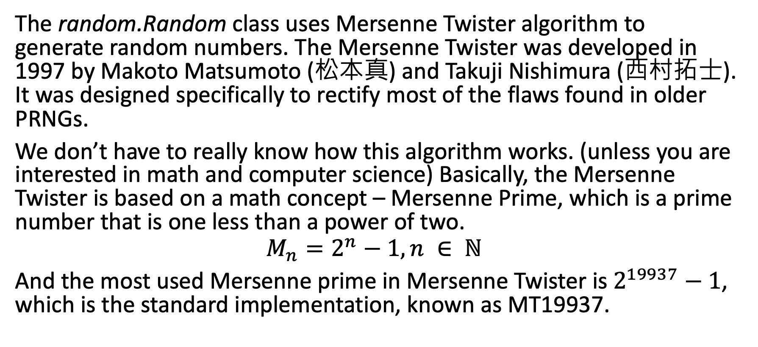
(Bonus) Random Algorithm
The random.Random class uses Mersenne Twister algorithm to generate random numbers. The Mersenne Twister was developed in 1997 by Makoto Matsumoto (松本真) and Takuji Nishimura (西村拓士). It was designed specifically to rectify most of the flaws found in older PRNGs.
We don’t have to really know how this algorithm works. (unless you are interested in math and computer science) Basically, the Mersenne Twister is based on a math concept – Mersenne Prime, which is a prime number that is one less than a power of two.
$$M_{n}=2^{n}−1, n ∈ ℕ$$
And the most used Mersenne prime in Mersenne Twister is $2^{19937}−1$, which is the standard implementation, known as MT19937.

Slide 34
(Bonus) Random Algorithm
However, the Mersenne Twister PRNG is not cryptographically secure; it’s because of observing a sufficient number of iterations (624 in the case of MT19937, since this is the size of the state vector from which future iterations are produced) allows one to predict all future iterations.
That means, if you are using random numbers for security purposes, DO NOT USE THE DEFAULT RANDOM CLASS AND ITS METHODS!! (I don’t want you to cause troubles.)

Slide 35
(Bonus) Random Algorithm
SystemRandom uses either the /dev/urandom file on POSIX systems or the CryptGenRandom() function on Windows NT systems. Both are Cryptographically secure PRNGs. (Known as CSPRNG)
The reason why we are involving OS is because – the random numbers are from the operating system, which has a special driver that gathers entropy from various real-world sources, such as variations in timing between keystrokes and disk seeks.
Can we predict exactly the time to the next keypress, or which key that will be, or when the next disk seeks will happen, or how long it will take - all of these are essentially unpredictable (even with physical access to the machine) so they can be used to generate a random number.

Slide 36
Random Number in Real Life
Here’s a list of where random numbers are used in computer:
Every encrypted connection on the internet needs some keys (for example, RSA algorithm in HTTPs, and Diffie-Hellman Key Exchange.) Keys are sent between client and server.
Model testing in Machine Learning. We can select some random data to be compared with.
Enemies appear in different coordinates on the screen. In video games (or Unity), random number generator is commonly used.

